Slide 1
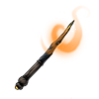


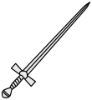
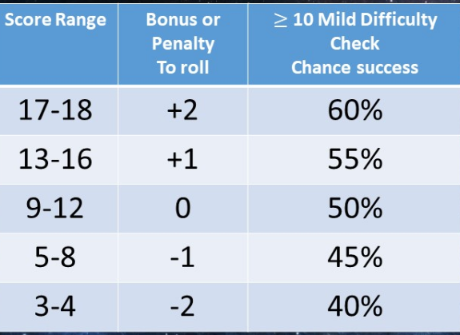
Character Name
Player Name
WHITE BOX CHARACTER CARD
AC
HP
Current HP
Saving Throw
STAT | SCORE | +/- | BONUS PENALTY
STR
DEX
CON
INT
WIS
CHA

Slide 2


ATTRIBUTES SKILLS SPELLS
GEAR: Circle either A or B (+ 50gp) Pack A: Backpack, bedroll, flint and steel, 12 torches, 50` rope, crowbar, 7 days rations and water skin, 2x30lb sacks. Pack B: Backpack, bedroll, flint and steel, hooded lantern with 6 pints lantern oil, hammer, 12 iron spikes, 10` pole, 7 days rations and water skin, 2x30lb sacks. Extra:
WEAPONS Weapon Melee: Bonus to hit + STR = Weapon Range: Bonus to hit + DEX = Unarmored 10 (+ DEX) Leather +2 (+ DEX) Chain +4 (+ DEX) Plate +6 Shield +1 Helmet (save from 1 critical hit then damaged)
Class:
Arrows/bullets

